Slide 1
Agenda
Methamatical Formulation of Linear Regression
Regularization
Regularization in Linear Regression
Need of Regularization
Apply Multivariate linear regression on boston Housing Dataset.
Assumption in Linear Regression
QnA session

Slide 2
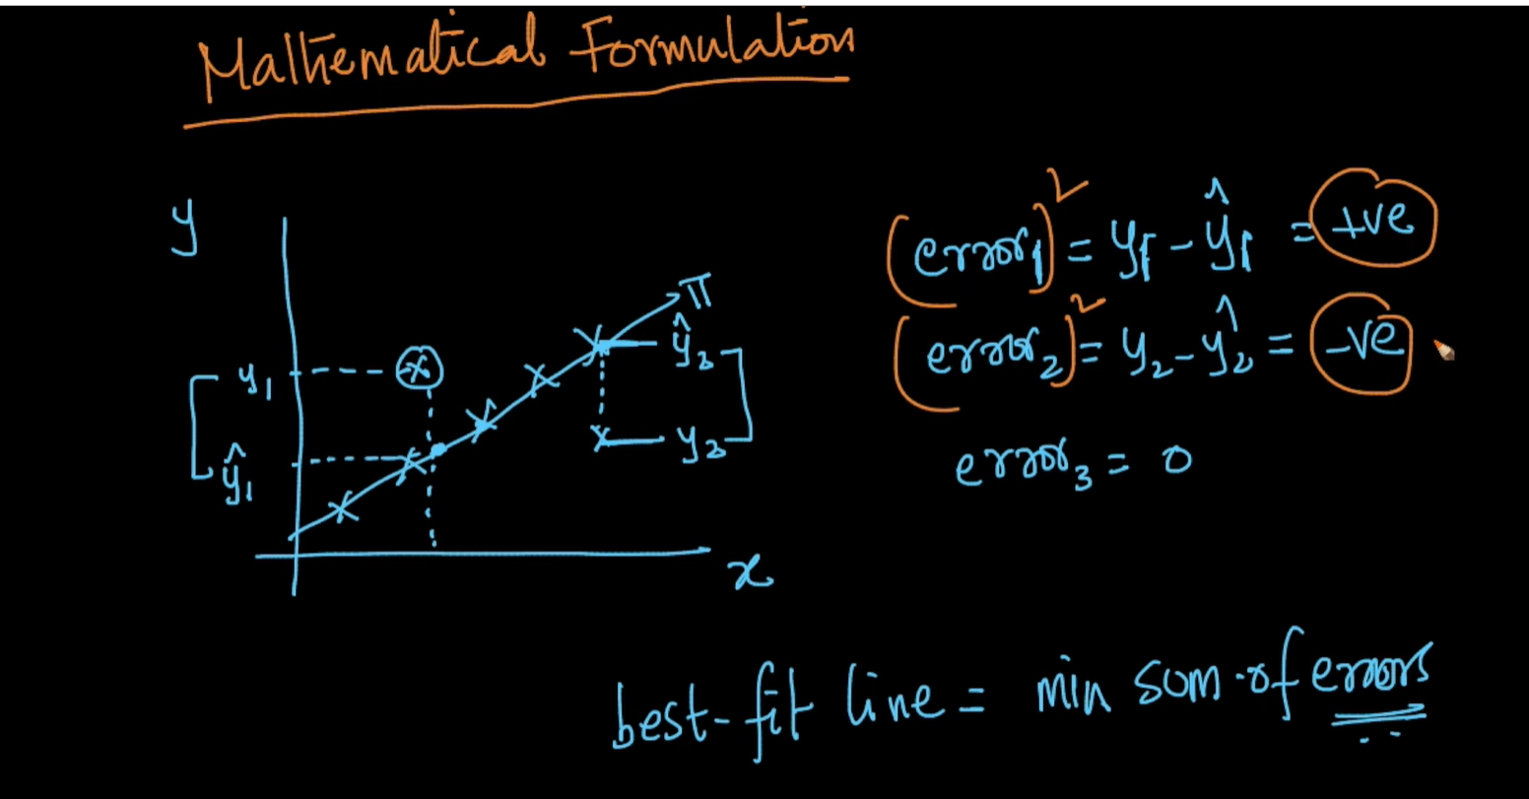

Slide 3
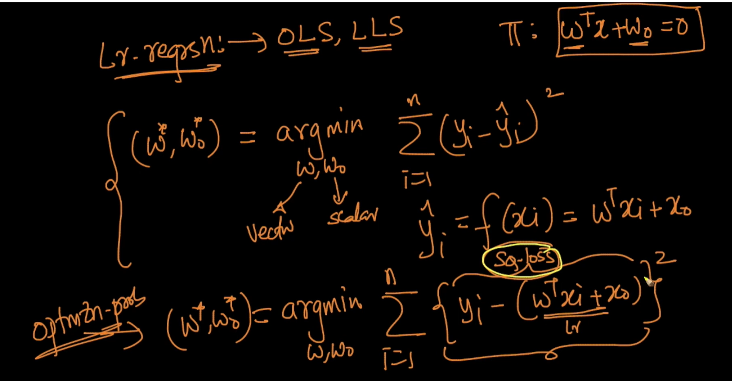
Linear Regression is also called as OLS (Ordinary Least Square) or LLS (Linear Least Square).

Slide 4
Regularization
One of the major aspects of training your machine learning model is avoiding overfitting. The model will have a low accuracy if it is overfitting. This happens because your model is trying too hard to capture the noise in your training dataset.
This is a form of regression, that constrains/ regularizes or shrinks the coefficient estimates towards zero. In other words, this technique discourages learning a more complex or flexible model, so as to avoid the risk of overfitting.

Slide 5
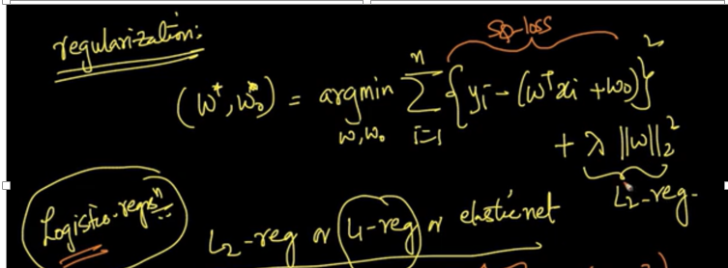
Regularization in Linear Regression
1. Linear regression with L2 regularization is also referred to as "Ridge Regression" 2. Linear regression with L1 regularization is also referred to as "Lasso Regression". 3. Linear regression with l1+L2 regularization is also referred to as "ElasticNet Regression".

Slide 6
Apply Multivariate linear regression on boston Housing Dataset
Import the data
Split into features and target
Apply train test split
Check multicolinearity using correlation matrix
Apply linear regression
Plot the prices and predicted prices
Calculate R_2 score and RMSE
Plot histogram of error

Slide 7
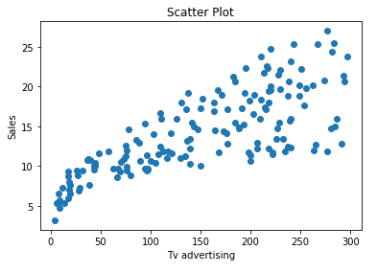
Assumptions of Linear Regression
Linear Relationship between the features and target:
According to this assumption there is linear relationship between the features and target. Linear regression captures only linear relationship. This can be validated by plotting a scatter plot between the features and the target.

Slide 8
Little or no Multicollinearity between the features:
Multicollinearity is a state of very high inter-correlations or inter-associations among the independent variables.It is therefore a type of disturbance in the data if present weakens the statistical power of the regression model.Pair plots and heatmaps(correlation matrix) can be used for identifying highly correlated features.
Homoscedasticity Assumption:
Homoscedasticity describes a situation in which the error term (that is, the “noise” or random disturbance in the relationship between the features and the target) is the same across all values of the independent variables. A scatter plot of residual values vs predicted values is a goodway to check for homoscedasticity.There should be no clear pattern in the distribution and if there is a specific pattern,the data is heteroscedastic.

Slide 9
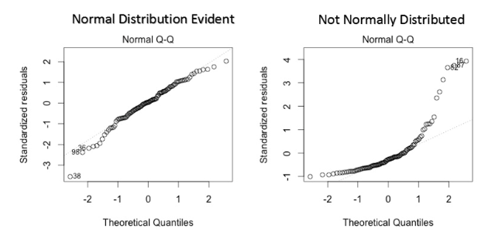
Normal distribution of error terms:
The fourth assumption is that the error(residuals) follow a normal distribution.However, a less widely known fact is that, as sample sizes increase, the normality assumption for the residuals is not needed. More precisely, if we consider repeated sampling from our population, for large sample sizes, the distribution (across repeated samples) of the ordinary least squares estimates of the regression coefficients follow a normal distribution.
Using the q-q plot we can infer if the data comes from a normal distribution. If yes, the plot would show fairly straight line. Absence of normality in the errors can be seen with deviation in the straight line.

Slide 10
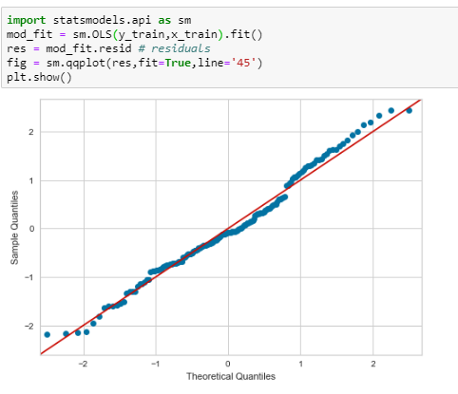
Little or No autocorrelation in the residuals:
Autocorrelation occurs when the residual errors are dependent on each other. The presence of correlation in error terms drastically reduces model’s accuracy. This usually occurs in time series models where the next instant is dependent on previous instant.

Slide 11
Question on linear regression
https://forms.gle/9YxCZZAded22jQW17
After analyzing the model, your manager has informed us that your regression model is suffering from multicollinearity. How would you check if he’s true? Without losing any information, can you still build a better model?
What are the basic assumptions to be made for linear regression?
How do you decide whether your linear regression model fits the data?

